Slide 1
LTI Advantage and how it applies to Tsugi and Sakai
Dr. Charles Russell Severance
Sakai PMC Chair
Clinical Professor, University of Michigan School of Information

Slide 2
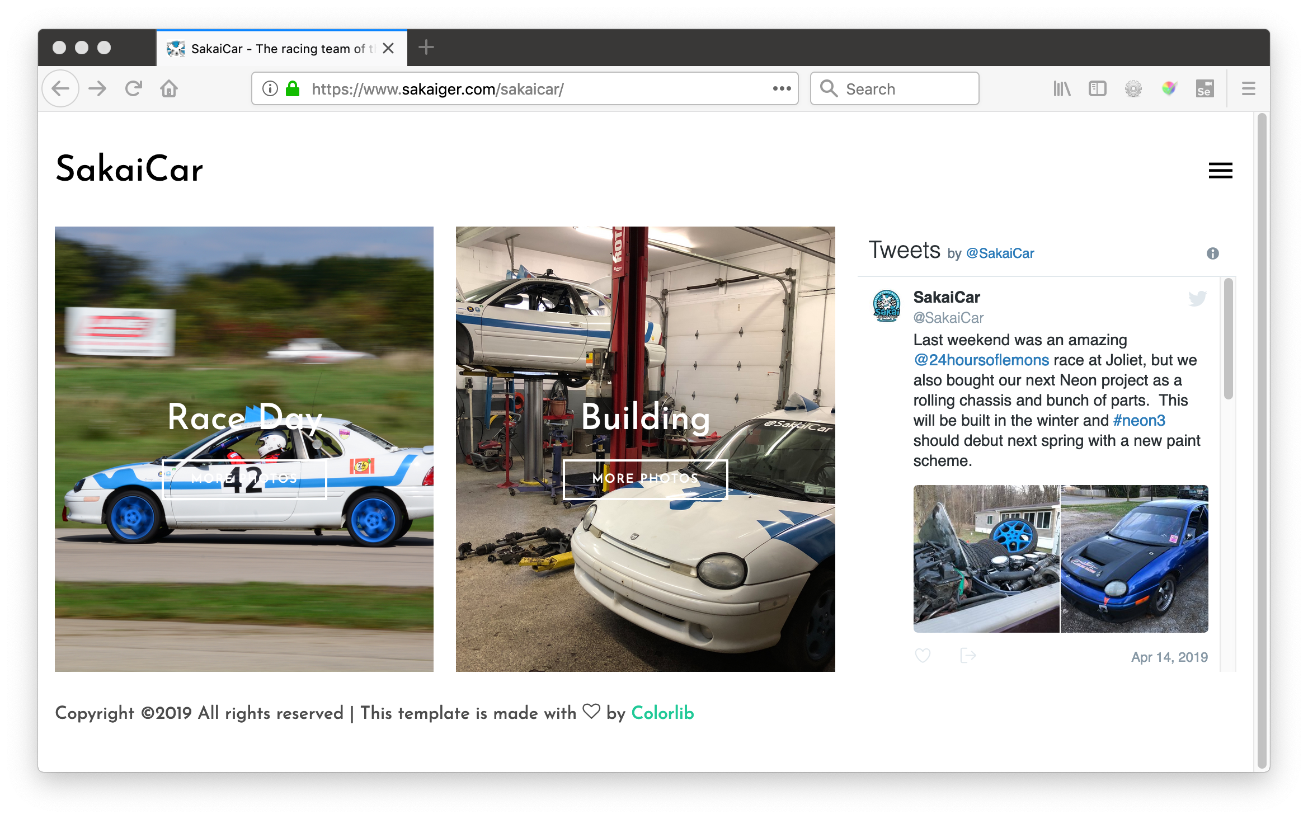

Slide 3


Slide 4


Slide 5
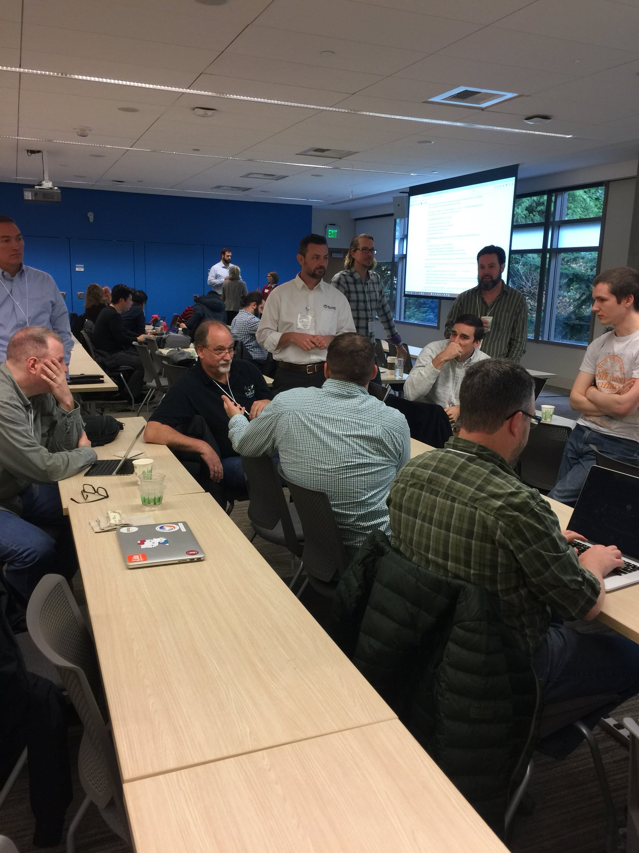
LTI Advantage
Any time now (05-2019)
Amazing scope:
Launch, Install, Membership, Gradebook
OAuth 2.0 / Java Web Tokens
Rapid Uptake:
Sakai, Canvas, Blackboard, Moodle
Tsugi, Cengage, Turnitin, VitalSource, McGraw-Hill
This will be disruptive

Slide 6
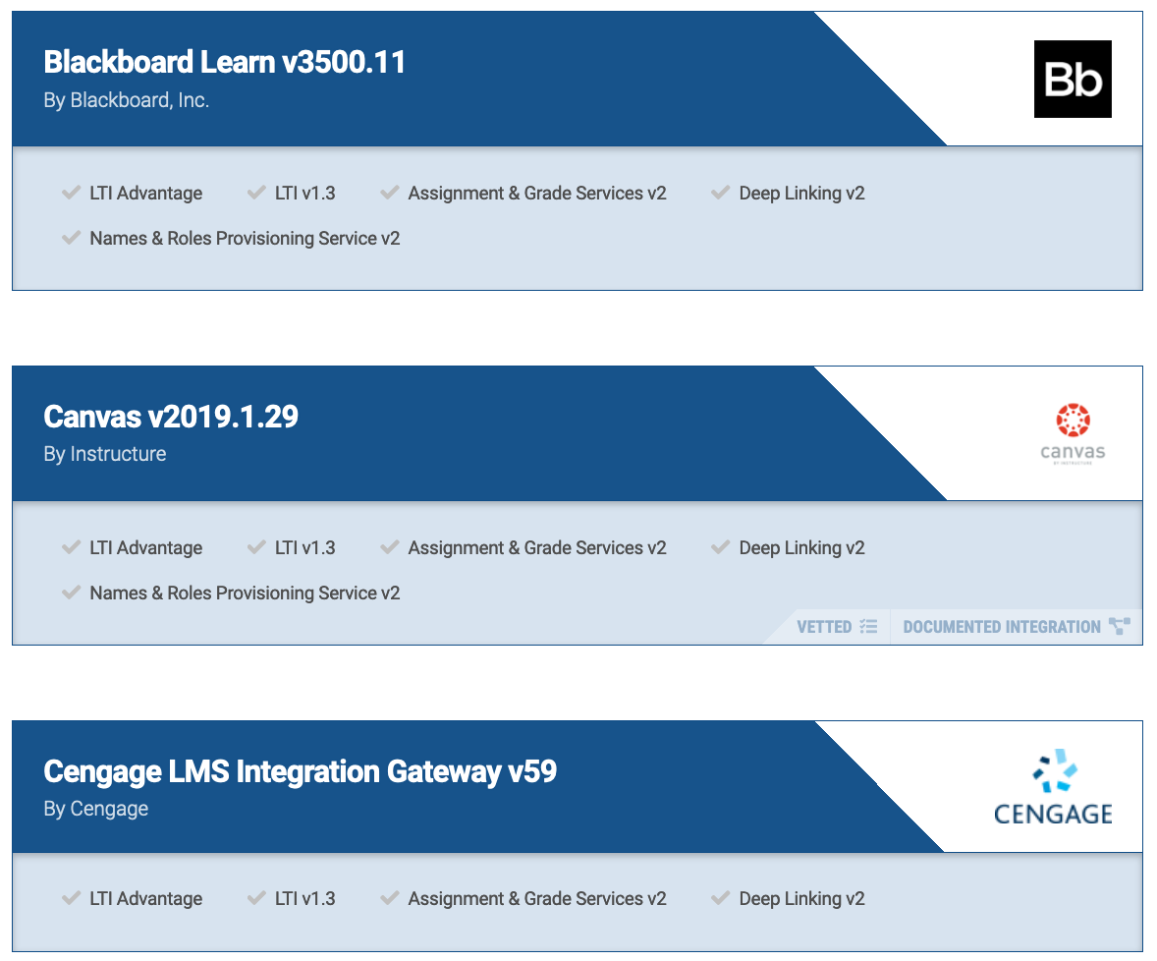
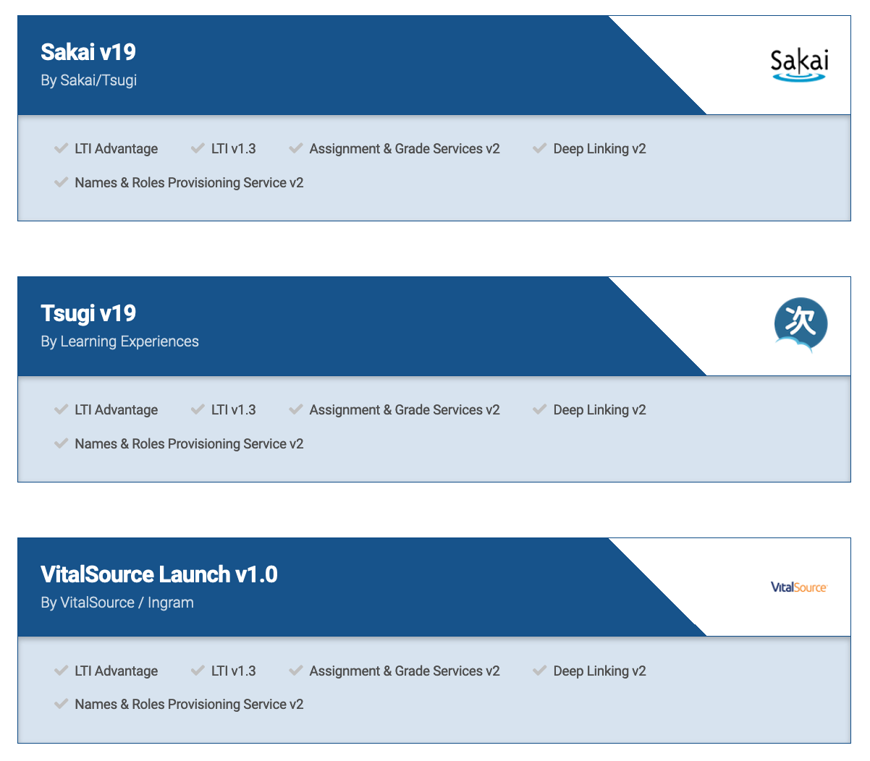
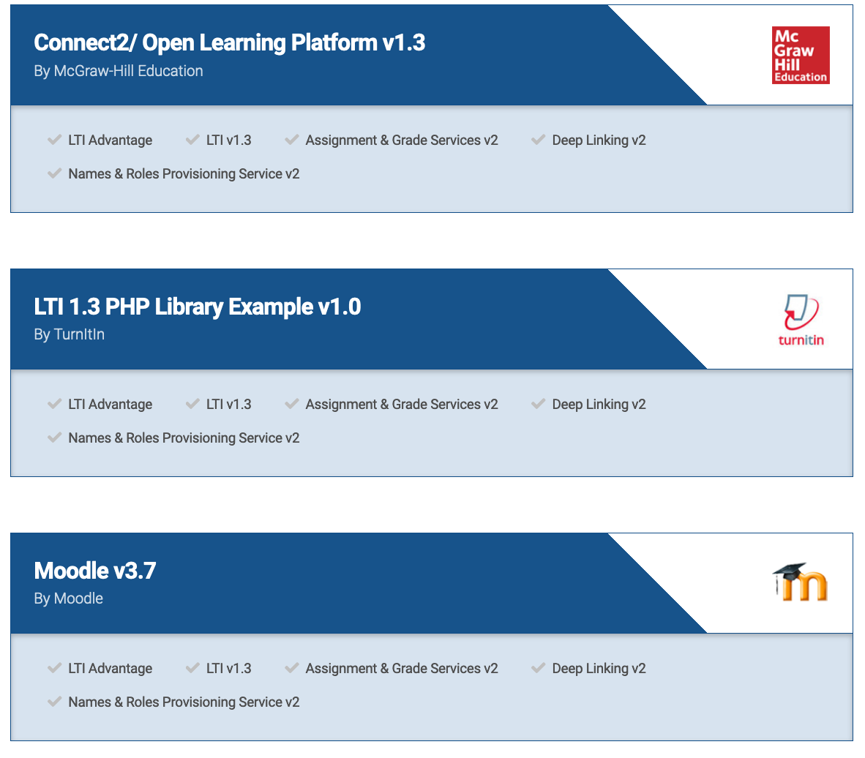

Slide 7
Sakai Advantage in LTI Advantage
Commercial LMS vendors moving towards multi-tenant SASS
LTI Advantage Integrations will be cross-tenant
Auto conversion from LTI 1.1 to LTI Advantage is nearly impossible
I predict that LTI 1.1 is going to be deprecated quickly
Disruption…
Moodle and Sakai have a much smoother 1.1 -> Advantage transition

Slide 8
LTI Advantage – Test Servers
Sakai and Tsugi are working cooperatively with everyone in the LMS space implementing LTI Advantage
https://test.tsugicloud.org/tsugi
https://test.sakaicloud.com/
Make an account, Join a site

Slide 9
Quick Demo

Slide 10
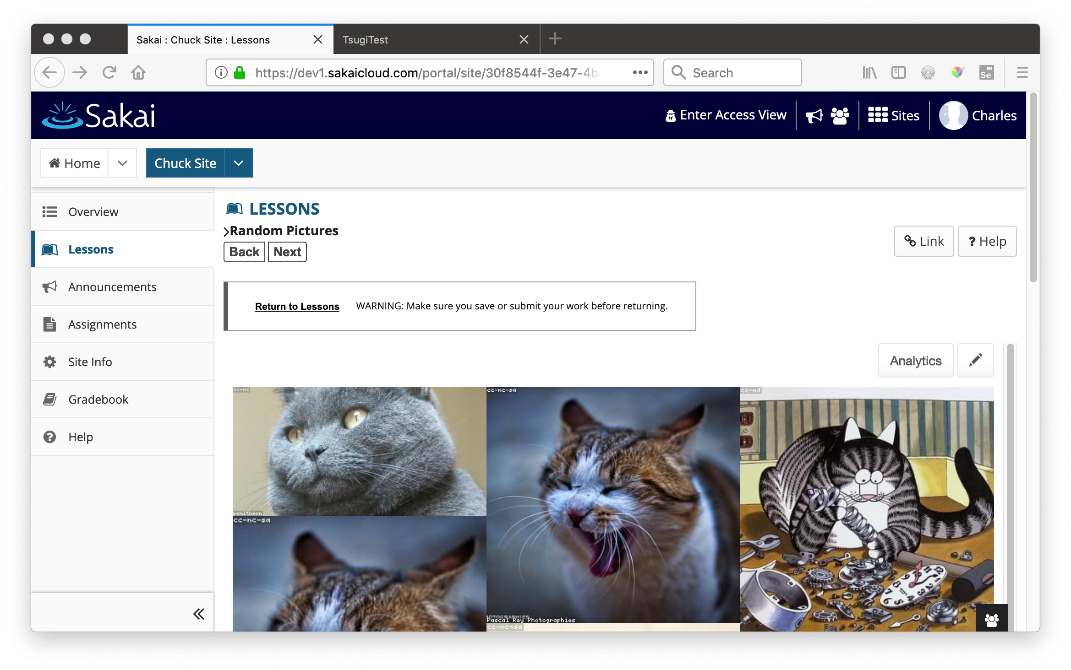

Slide 11
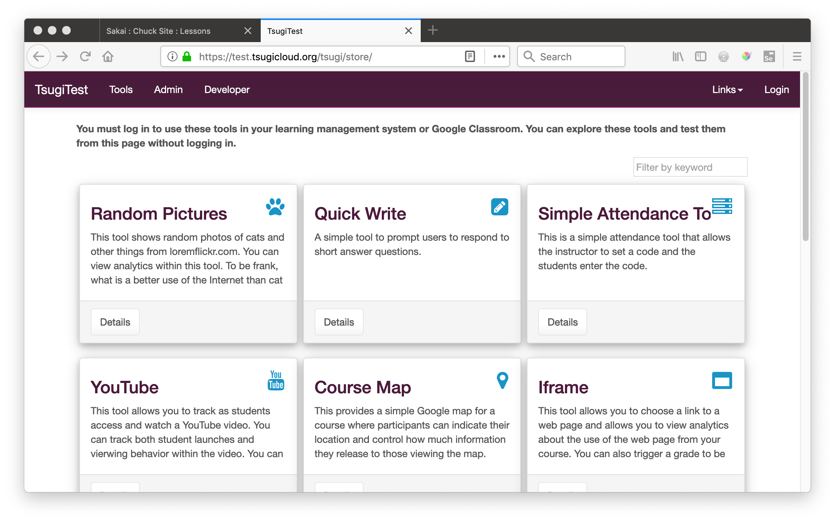

Slide 12
Tsugi Update
tsugi-php – Very mature
LTI 1.1, LTI Advantage, Google Classroom
Runs at Scale – Amazon
Free Hosting www.tsugicloud.org
Commercial provider: www.learnxp.com
tsugi-util (Java)
Will be updated to LTI 1.3
Deprecated: tsugi-node, pytsugi, tsugi-java
Emerging: django-tsugi

Slide 13




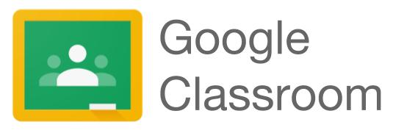

LTI 1.0
LTI 1.1
LTI 2.0
LTI Advantage
Google Classroom
Tsugi
JWT Launch
RPC AP

Slide 14
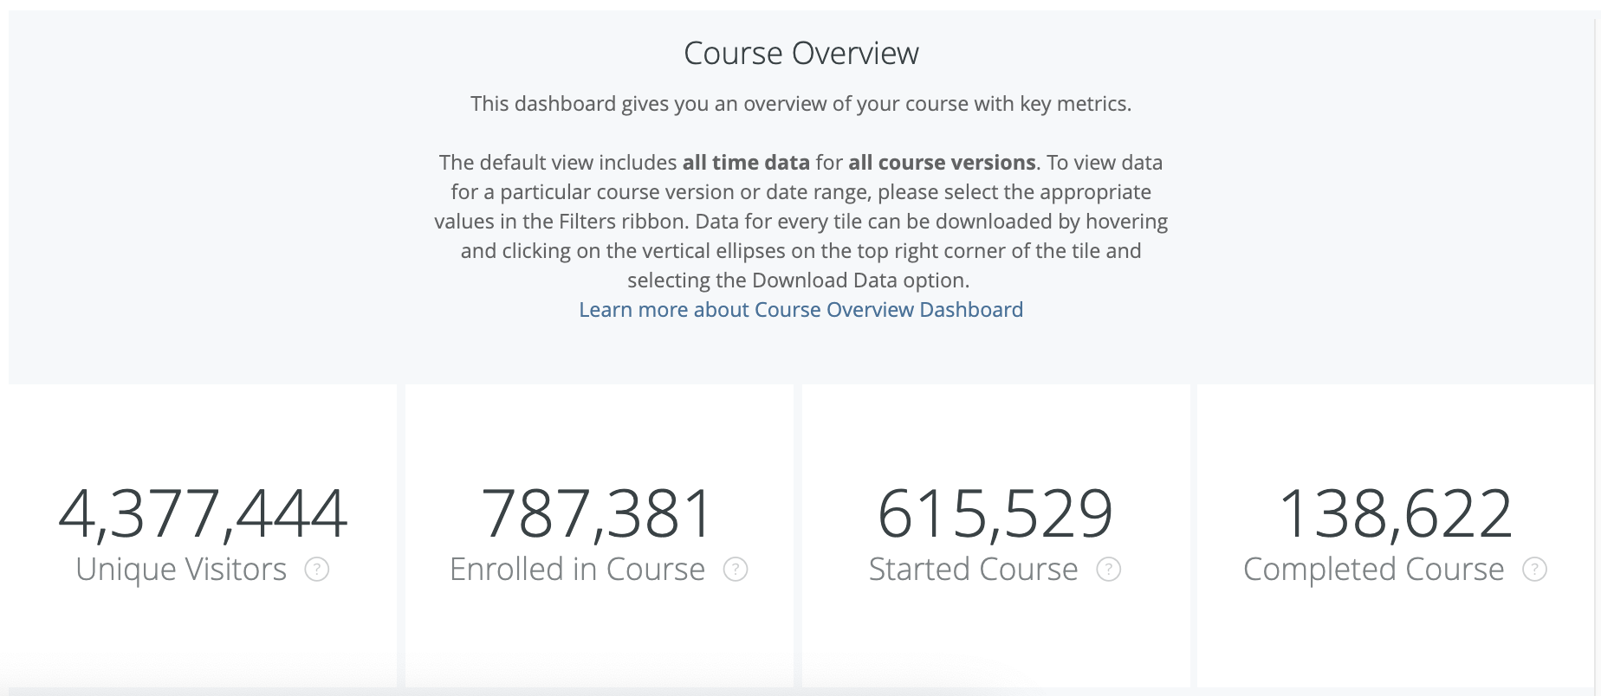
Python for Everybody: Coursera

Slide 15
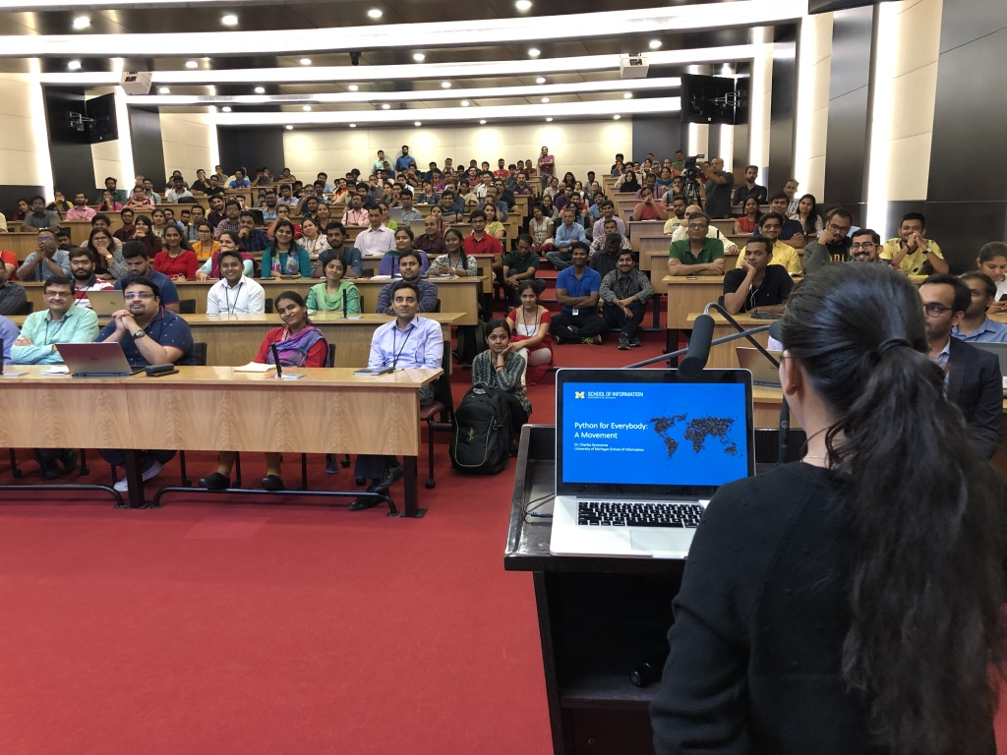

Slide 16
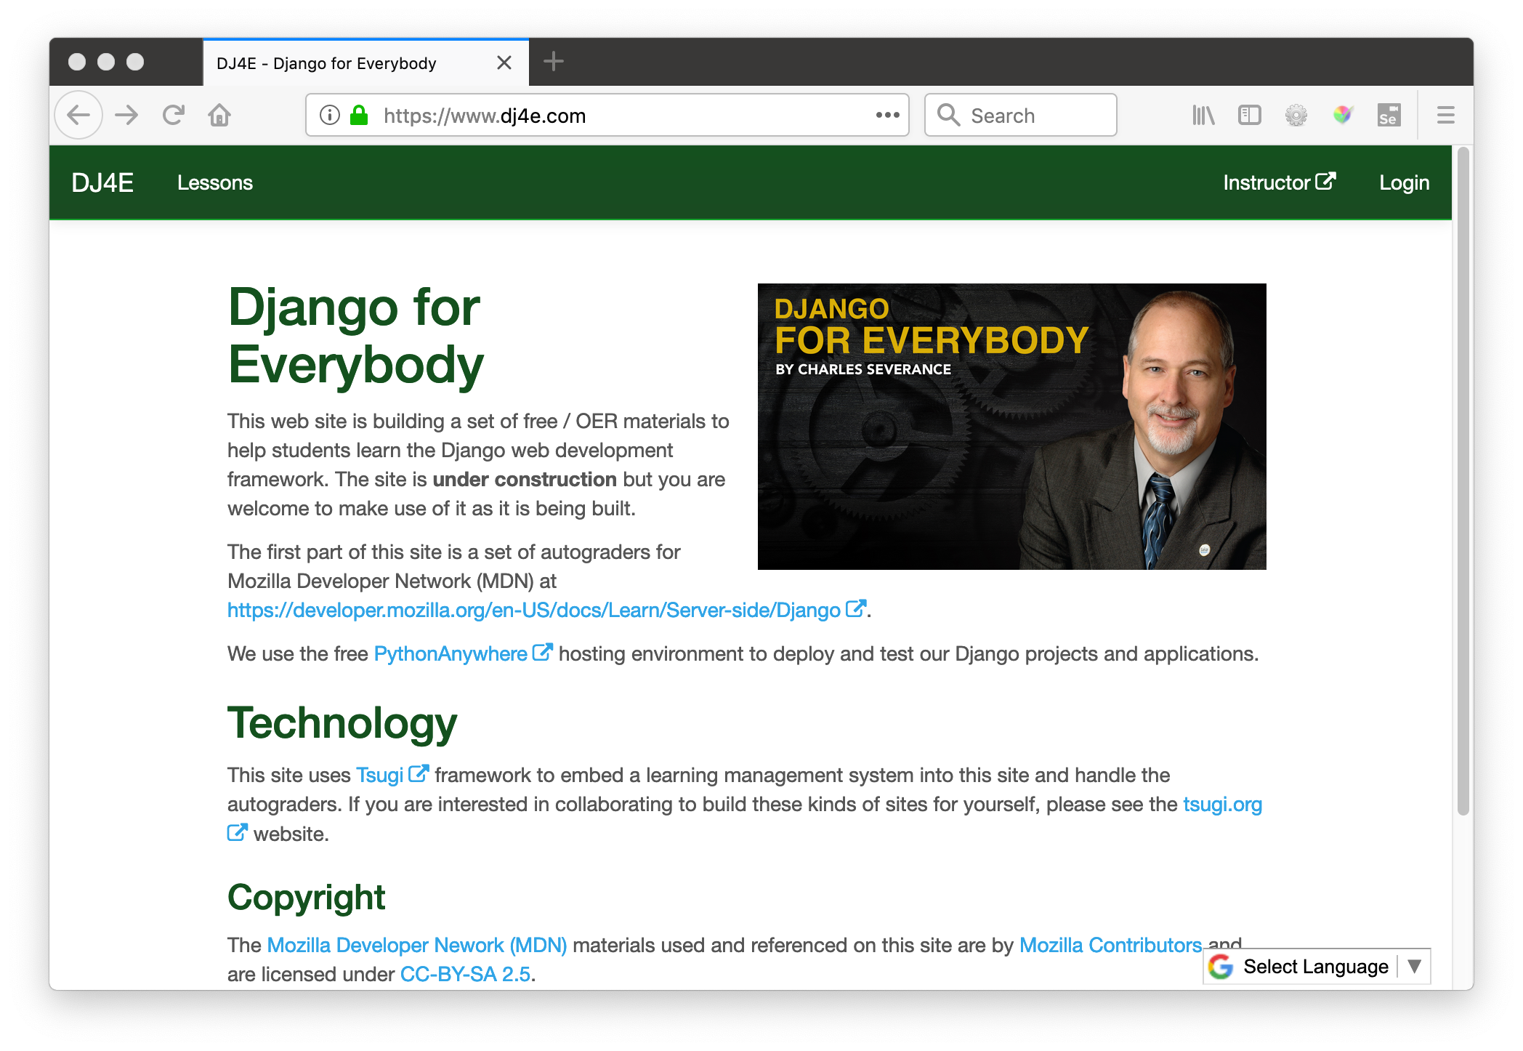

Slide 17
If I were building an open source LMS today..
It would be written in Python / Django
It will use IMS LTI Advantage as its internal architecture
APIs will be OAuth 2.0 / JWT based
It will elegant and easy to understand / modify
It would cover the entire scope of Canvas/Sakai and OpenEdX – one LMS for on-campus and online
It would be an "App Store" – Every tool will be available as an "App"
It will be a "Learning Object Repository" – All content will be exportable

Slide 18
Tomorrow's Workshop – Tsugi Django
Instructions - https://www.tsugi.org/django.txt
Make an account on www.pythonanywhere.com
Set up virtual environment
Pull down https://github.com/tsugiproject/djtest
Get it running in PythonAnywhere
Link it into test.tsugicloud.com
Install it into https://dev1.sakaicloud.com
Launch as student – send a grade from Django to Sakai

